Slide 1

Local area help and advice
Building and implementing an effective local workforce strategy

Slide 2
How to use this support...
Practical, “how to”, guide designed to support local areas at each stage:
at the start: trying to understand what a workforce strategy is and its local, regional and national context
already underway: either reviewing or refining a workforce strategy
complete: and ready to be promoted and implemented
being implemented: requiring sustained focus and momentum, as well as regular review to ensure it is having the desired impact

Slide 3
Using the local workforce strategy product diagnostic
Is a useful place to start the development or review of a local workforce strategy
Can be used at any stage to guide your engagement with the local workforce strategy product
It is recommended that you review progress of your local workforce strategy against the diagnostic regularly

Slide 4
What is a local workforce strategy?
Provides direction
Local workforce strategy
Informs
Workforce plans
Training and
development plans
Recruitment and
retention plans
Succession plans
Leadership development
plans
Continuous professional
development plans

Slide 5
12 key modules
Building and implementing an
effective local workforce strategy
The guide
has 4 main
sections
Local workforce
strategy context
and alignment
The process
of creating a
workforce strategy
Implementing the
local workforce
strategy
Sustaining a
successful
workforce
strategy
The sections are useful at different stages of the process
When trying to understand what a workforce strategy is, and its local, regional and national context
When the strategy process is already underway, or reviewing or refining a workforce strategy
When ready to promote and implement a completed workforce strategy
When wanting to ensure the implementation maintains momentum and is having the desired impact
Linking local
objectives for
children’s services
Project managing
the workforce
strategy activity
Designing the
workforce strategy
document
Establishing an
effective strategy
cycle
Each section is broken down into a number of modules
Aligning workforce
strategy locally
Defining a shared
vision of where we
want to be
Launching, promoting
and communicating
the strategy
Monitoring and
measuring the
strategy activity
Aligning nationally
and regionally
Crafting workforce
strategy actions
Implementing the
workforce strategy
actions
Reviewing the
impact of the
workforce strategy

Slide 6
The critical enabler of the CYPP
VISION
for children and young people
The children and
young people’s plan
Local workforce strategy

Slide 7
The strategy process
Gather
data
Create
Vision
Conduct
Review
Workforce strategy cycle
Implement
Actions
Conduct
Gap
Analysis
Develop
Strategy

Slide 8
Context and alignment
Have we developed clear links between the workforce strategy and the children and young people’s plan?
Have we aligned the workforce strategy locally?
Local workforce strategy context
and alignment
Have we aligned our workforce strategy nationally and regionally?

Slide 9
The strategy process
Have we defined a shared vision of where we want to be?
Are we effectively project managing the workforce strategy activity and cycle?
The process of creating a
local workforce strategy
Do we know what we have to do in order to achieve our vision?

Slide 10
Implementing the strategy
Are we confident about the implementation of our workforce strategy?
Implementing the local workforce strategy
Have we thought how best to launch and then promote and communicate about the workforce strategy on an ongoing basis?
Are we effectively implementing the workforce strategy actions?

Slide 11
The strategy process
Do we have an effective, agreed, workforce strategy cycle?
Sustaining a successful
local workforce strategy
Are we confident that we are doing the right things, and doing things right?
Are we monitoring and measuring how effectively we’re managing the workforce strategy cycle and activities?

Slide 12
Top ten things to get right
Agree what we want the strategy to achieve
Ensure the strategy fits with all the other related activities
Engage the right people in developing and implementing the strategy
Get the structure right
Build a compelling vision of the kind of workforce we need
Get creative in tackling the really challenging workforce issues
Activities are designed for maximum demonstrable impact
Get the look and feel right
Launch the strategy successfully
Ensure the strategy is sustainable

Slide 13

Module 1 – context and alignment

Slide 14
Linking to the Children and Young People’s Plan
Exercise 1.1
Identify the workforce implications of the children and young people’s plan
Exercise 1.2
Map the cycles of the children and young people’s plan and workforce strategy
VISION
for children and young people
The children and
young people’s plan
Local workforce strategy

Slide 15
Module 2 – context and alignment

Slide 16
Aligning workforce strategy locally
Exercise 2.1 Create a children’s workforce stakeholder map
Exercise 2.2 Map local partnership arrangements
Exercise 2.3 Identify the local priorities for the children’s workforce
This stage provides an excellent opportunity to consult children and young people, and get staff from all levels and sectors to participate in framing a vision for the future children’s workforce

Slide 17
The local context
VISION
The children and
young people’s plan
Sub groups
Local workforce strategy
Workforce development, Commissioning, Locality
Local
Safeguarding
Children Board
Children’s partnerships
Children’s plan, Local Workforce Strategy
Local Strategic Partnership
Local Area Agreement, Community Strategy, Local Programmes and Initiatives

Slide 18
The local context
Government departments
Policy, national programmes and initiatives
VISION
Local partnerships and collaborations
Interpretation, execution, administration, regulation, local support
The children and
young people’s plan
Sub groups
Workforce development, commissioning, locality
Children’s partnerships
Children’s plan, local workforce strategy
Local workforce strategy
Local Strategic Partnership
Local Area Agreement, Community Strategy, Local Programmes and Initiatives
Local
Safeguarding
Children Board

Slide 19
Framework for a partnership map
Early years
Education
Health
Voluntary
sector
Local
Authority
Children’s
Services
Social,
family and
Community
Support
Private
Sector
Culture
Youth
Sport
Justice
and Crime
Prevention

Slide 20
Framework for a partnership map
Child minders networks
Early years
Education
School support
Health visitors
Health
Voluntary
sector
GP practice managers
Family intervention
Local
Authority
Children’s
Services
Residential units
Social,
family and
community
support
Private
sector
Foster carers
Library staff
Culture
Youth
Sport
Justice
and crime
prevention
youth services
Summer play schemes
YOT
Leisure services

Slide 21
Module 3 – context and alignment

Slide 22
Government departments relating to workforce
Department for Education
(DfE)
Early years
Education
Social, family and community support
Youth
Department of Health
Health
Voluntary, Community and Private Sector
Crown Prosecution Service
Justice and Crime Prevention
Home Office
Ministry of Justice
Department for Culture,
Media and Sport
Sport and Culture

Slide 23
Sector skills councils relating to workforce
Skills for Care and
Development
(includes CWDC)
Early years
Social, family & community support
Youth
Lifelong Learning UK
Education
Skills for Health
Health
Voluntary, Community and Private Sector
Skills for Justice
Justice and Crime Prevention
Skills Active
Sport and Culture
Creative and Cultural Skills

Slide 24
Aligning nationally
Exercise 3.1: Identify the national priorities for the children’s workforce
Government departments
Policy, national programmes and initiatives
Local partnerships and collaborations
Interpretation, execution, administration, regulation, local support
VISION
The children and
young people’s plan
Local workforce strategy

Slide 25
Module 4 – creating the strategy

Slide 26
Project managing workforce strategy activity
Exercise 4.1 Create a workforce strategy project plan or project charter
Exercise 4.2 What can we learn from the past?
Exercise 4.3 Establish the scope of the workforce strategy project
Exercise 4.4 Identify which stakeholder groups to engage with and when
 | What worked well | What worked so-so | What did not work well
With the strategy process / activities | It brought children’s services partners together | It remained relevant but we could have refreshed it more often | It was not cascaded throughout the organisation
With the content of the strategy | It focussed our attention on the key workforce issues we needed to tackle | We got the right balance on activities that would contribute to most of our key priorities | We were far too ambitious – we could never have delivered everything we set out to

Slide 27
Who to engage, and when…
Stakeholder group | Aligning the strategy | Designing the strategy | Implementing and promoting the strategy | Sustaining the strategy
Sponsor | Agree vision/ enable interviews | Enable workshops and focus groups | Sign off/ promotion | Ongoing sponsorship
Senior stakeholders | Agree vision/ enable interviews | Agree actions | Internal promotion / prioritisation
Workforce strategy group | Oversee activity | Creative solution workshop / oversee | Identifying resources / oversee | Monitor and review
Staff |  | Review the past: future ideas |  | Ongoing engagement
Children and young people | Focus groups needs and want from workforce | Creative ideas / prioritising action | Help design children and young peoples version
HR department | Interviews |  | Implementing actions | Measurement
Communication and marketing teams |  |  | Publish and promote strategy

Slide 28
Scoping the workforce strategy
Ambitions
Elements
VISION
Learning and development elements
Training, induction, elearning, job shadowing, mentoring, continuous professional development
The children and
young people’s plan
Recruitment and retention elements
Recruitment, compensation and benefits, recognition, appraisals, equality and diversity
Local workforce strategy
Staffing levels, demand planning, skills database, temporary staff, labour supply, absenteeism and turnover management
Workforce planning elements
How the workforce strategy activity will influence people within the children’s workforce
Leadership and succession elements
Succession, mentoring, talent management and leadership training
Integrated working elements
Secondments, job swapping, resource pooling, co-location
How the workforce strategy document will influence people within the children’s workforce
Performance management elements
Appraisals, reward, engagement, high performing teams, quality assurance, alignment, vision

Slide 29
Prioritising agreed ambitions
Ambition | Importance | How will we know?
Raise the profile of workforce development across the partnership | H | Workforce development on the agenda Workforce development issues prioritised, resourced and actioned
Greater effectiveness and efficiency of workforce development activities | H | Coordinated training and development programmes – greater value for money Joint commissioning from providers
Create alignment with children’s plan and ECM outcomes | M | Clear links between workforce development actions and children’s plan objectives
Introduce stretch and challenge | M | Collaboration and participation in decision making Creative solutions for root problems
Clarity of roles and build relationships | L | More opportunities for peer to peer networking Staff demonstrating a better understanding of roles and service offers across the trust

Slide 30
Module 5 – creating the strategy

Slide 31
Defining a shared vision of where we want to be
Exercise 5.1 Create a vision statement
National level
Local level
Vision for Children and Young People
Be healthy
Stay safe
Enjoy and achieve
Make a positive contribution
Achieve economic wellbeing
Vision for children and young people:
Set out in children and young people’s plan
Local workforce strategy
vision
Vision for the area:
Set out in local community strategy
Vision for the children’s workforce which is:
Ambitious for every child and young person
Excellent in their practice
Committed to partnership and integrated working
Respected and valued as professionals
Vision for people working with children and young people:
Set out in sector specific workforce strategies

Slide 32
Defining a shared vision of where we want to be
Local workforce strategy
vision
Key focus areas
Exercise 5.2
Identify the key focus areas or strategic themes
Recruiting and
retaining the
best people
Modernising
the children’s
workforce
Developing a
pipeline of
excellent
leaders
Integrated
Working and
services
Exercise 5.3
Agree a core set of principles
Initiatives grouped by focus area:
Mentoring
Succession
planning
CPD

Slide 33
Module 6 – creating the strategy

Slide 34
Crafting workforce strategy actions
Potential workforce strategy action
Desired response to activity
Desired outcome
How trust is measuring progress (KPI)
Potential root cause of issue
Local children’s partnership objective
Improve CAF support for practitioners
Increase the proportion of the workforce using CAF effectively
Young people receive support earlier
Decrease in re-offending rates
Decrease in substance misuse
Lack of confidence across services in using CAF as an effective solution
Increase support to young people to break cycles of crime and drug use

Slide 35
Mapping impact across the workforce
Exercise 6.3 Mapping likely impact
Decrease re offending rates and substance misuse
Safeguarding children and young people
Improved education outcomes
Narrowing the gap
Improvements in recruitment and selection
M
H
M
H
Standardised, high impact induction across children’s services
M
H
L
M
Develop e-learning portal
L
L
H
M
Improve CAF support for practitioners
H
H
L
M

Slide 36
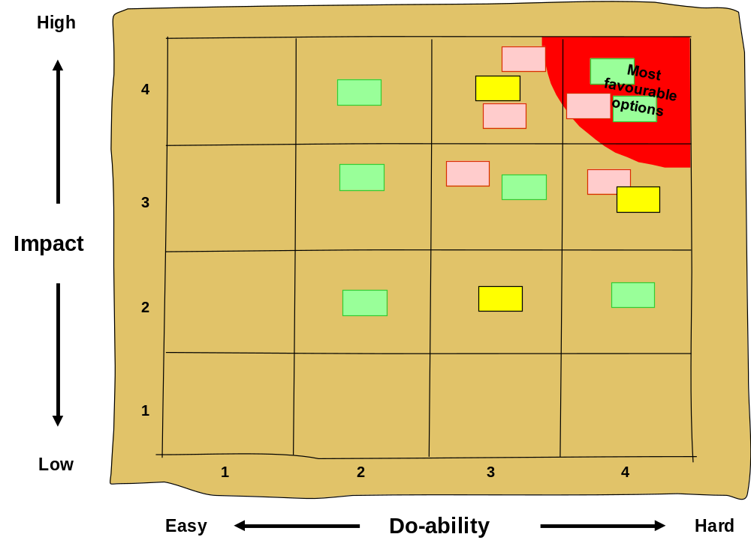
Prioritising workforce strategy actions

Slide 37
Creative thinking techniques
Purpose | Recommended techniques
Service improvement | Reversal, SCAMPER
Many new ideas | Brainstorming, Ideastorming, 6-3-5 brainwriting, Windtunnel
Getting to the root cause of issues | WILO, Fishbone analusis, the 5 ‘why’s
Problem solving / creative solutions | Osborn-Parnes, Provocation, Appreciative enquiry, 6 thinking hats

Slide 38
Module 7 – implementing the strategy

Slide 39
Designing the local workforce strategy document
Exercise 7.2: Identifying target audience groups
Target audience group | How they use the workforce strategy document | Main areas of interest | Level of detail required | Preferred format and media | How we will meet their needs
The local partnership members and subgroups including: Workforce development group Etc.
Director of Children’s Services
Other senior level sponsors within each sector or organisation

Slide 40
Options for structuring the strategy document
Local Workforce strategy vision
Priority 1
Decrease
reoffending
rates and
Substance
use
Priority 2
Safeguarding
children and
young people
Priority 3
Improved
education
outcomes
Priority 4
Closing the
gap
Local Workforce strategy vision
1. Structuring by the key children and young people’s plan priorities
Recruiting
and
retaining
Modernising
Motivating
and
developing
Deploying
2. Structuring key focus areas by the main stages of workforce activity

Slide 41

Options for structuring the strategy document
Local workforce strategy vision
Integrated
working
Performance
Management
New ways of
working
Leadership
and
management
Training
And
Development
Recruitment
and
retention
Sector
workforce
planning
Local workforce strategy vision
3. Structuring key focus areas by the main themes of workforce activity
4. Structuring key focus areas by strands of the Children’s Workforce Framework

Slide 42
Module 8 – implementing the strategy

Slide 43
Launching, promoting and communicating the strategy
Exercise 8.1 Establishing communication support and sign off
Communication plan guidelines
Create a communications plan which:
contains a mix of push and pull approaches
builds up understanding over time
makes use of a variety of media channels and communication formats
sets out how ongoing, regular communication will be achieved
includes processes to ensure opportunities to promote successes or endorsements are not lost
establishes mechanisms for capturing and responding to feedback
regularly measures and reviews the effectiveness of communications in achieving wide-scale awareness or depth of understanding in certain audience groups.

Slide 44
Module 9 – implementing the strategy

Slide 45
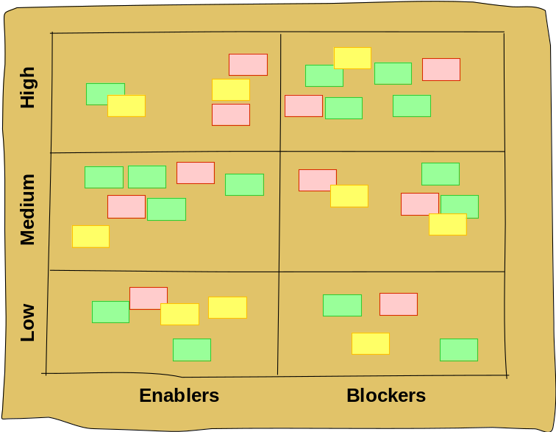
Implementing the workforce strategy actions
Exercise 9.1 Identifying the internal factors enabling or blocking implementation
Key internal factor | Enabler or blocker | Degree of impact | How it could be leveraged / overcome
Many line managers don’t release staff attend training or participate in workforce development related projects or events | Blocker | high | Coaching, training and communication with line managers to promote the benefits to them of workforce development Immediate and continually reinforced messages and encouragement form senior managers to priorities workforce development
The contact details database for people working with children and young people in a voluntary capacity is not up to date | Blocker | medium | Establish an action to bring database up to date Consider introducing a self-managed system using media to ‘pull’ the information in from voluntary workers
Our method of cascading communications via team meetings is working well | Enabler | medium | Use as primary communication method for workforce strategy progress reports, announcing successes and obtaining feedback See what could be learned and shared across partners

Slide 46
Implementing the local workforce strategy actions
Overall Change Sponsor
Sponsors act as advocates, removing obstacles, enabling decision making and resources, providing challenge
Change Programme Manager
Sector sponsors
and senior
stakeholders
Reporting, programme coordination and administration; project team support
Such as Workforce Development Group
Strategic theme
owner
Overseeing theme related projects, facilitating collaboration and shared learning, avoiding overlap and duplication
Exercise 9.2
Achieving accountability through the project and programme structure
Function or
Service
Managers
Project Managers
Project Managers
Implementing at local level as part of normal remit; embedding into systems and processes; reporting
Project managing team (could be multi-agency) to implement strategy, reporting

Slide 47
Implementing the local workforce strategy actions
Exercise 9.3 Identifying the required tasks and likely impact of local workforce strategy actions at team level
Workforce Strategy action | Tasks we are required to do | What changes we are likely to see for our team | Additional tasks and actions we will need to take
Adopt a common vision for the workforce | None | A refreshed sense of purpose due to focus on the vision A better sense of belonging to the workforce | Change the vision posters in the office Revise the agenda for the strategy away day to include time to think about the vision and what it means to us
Embed the Common Core of Skills and Knowledge in all training programmes | Review and adapt the content of training and induction programmes to reflect the Common Core | A well defined framework for future induction and training programme design A basis for coordination of multi-agency basic skills and knowledge training and development | Explore whether the Common Core could be used as a framework for upcoming skills audit and training need analysis Contact external training providers to ensure their programmes are adapted

Slide 48
Module 10 –sustaining the strategy

Slide 49
Establishing an effective strategy cycle
Exercise 10.1 Design and agree a linked up workforce strategy cycle
Aligning planning cycles
There are other cycles which will need to be linked up with the strategy cycle, such as:
The development cycle of the Children and Young People’s Plan
Commissioning processes (where workforce strategy can help to inform needs analysis or provide solutions where gaps are identified).
Budget processes, to ensure that resources required for the successful implementation of the workforce strategy actions are allocated and proposed changes to the cost base are taken into account
Performance management cycles within each of the partner organisations so that objectives can be built in support of the workforce strategy vision, and appraisals can be aligned accordingly
Staff training needs assessment and personal development planning
External cycles, such as the CWDC children’s workforce self-assessment cycle

Slide 50
Module 11 – sustaining the strategy

Slide 51
Monitoring and measuring the strategy activity
Exercise 11.1
Establish project and action progress reporting mechanisms
Exercise 11.2
Identify and mitigate potential risks to the workforce strategy cycle
Gather
data
Stages of implementation
Stages of implementation
Conduct
Review
Create
Vision
Action or
Action or
Stage 1
Stage 1
Stage 2
Stage 2
Stage 3
Stage 3
Project
Project
Project 1
Project 1
Workforce strategy cycle
theme 1
theme 1
Strategic
Strategic
Project 2
Project 2
Project 3
Conduct
Gap
Analysis
Project 3
Implement
Actions
Develop
Strategy

Slide 52
Identifying and mitigating risks to the strategy
 | IMPACT (most likely impact, if in doubt grade up, not down)
Probability (likelihood of occurrence) | Insignificant |  | Minor | Moderate | Major | Catastrophic
 | 1 |  | 2 | 3 | 4 | 5
Almost Certain | 5
Probable (highly likely) | 4
Likely | 3
Possible | 2
Rare | 1
Actions on risk fall broadly under four categories:
Terminate
Treat
Transference
Tolerate
Risk Identification | Risk Assessment (H,M,L) | Actions on Risks | When to monitor next

Slide 53
Module 12 – sustaining the strategy

Slide 54
Reviewing the impact of the workforce strategy
Exercise 12.1 Review the impact of the workforce strategy
Action | Desired / planned impacts | Impact achieved so far | Evidenced by: | Comments / further actions
How Local Area is measuring progress | Resulting issue | Workforce related root cause of issue |  | Desired Outcome | Proposed workforce strategy action | Workforce Strategy objective
Decrease in re-offending rates Decrease in substance misuse | How to support young people to beak cycles of crime and drug use | Lack of confidence across services in using CAF effectively |  | Young people receive support earlier | Improve CAF support for practitioners | Increase the proportion of the workforce using CAF effectively

Slide 55

Creative solutions – case studies

Slide 56
Creative solutions – case studies
Waltham Forest - E-learning community
Why was a solution needed?
Waltham Forest wanted to have the internal capacity to grow and develop their own workforce rather than recruiting skills from external sources.
The Learning and Development team also wanted the workforce to have the opportunity to undertake blended learning activities in which they can select the best activities to suit their own pace, learning style and level, as well as time and place using a range of techniques and resources.
What solution was developed?
Waltham Forest subscribed to Learning Pool, an e-learning exchange company for the public sector. This allows Waltham Forest to create, share and access e-learning content with the 86% of councils in the country who belong to the Learning Pool community.
They are currently in the process of rolling out e-learning in the authority. This has involved raising awareness of their e-learning zone, how to access and use the e-learning and resources and also encouraging services to learn how to develop their own e-learning materials.
What is the desired impact of this solution?
The use of Learning Pool should result in Waltham Forest having a highly knowledgeable workforce through their ability to share resources and learn from their peers in other Children’s Trusts. The workforce will be able to access information and training instantly rather than having to wait for appropriate training courses to become available.
East Sussex - Online support for
third sector workforce development
Why was a solution needed?
Many third sector organisations aren’t able to provide training programmes for staff and volunteers due to cost and resource restrictions. East Sussex Children’s Services wanted to find a method of enabling organisations to help each other to train and develop their staff and volunteers in a collaborative and cost effective manner.
What solution was developed?
Using the Workforce Strategy Partners Programme (WSPP) grant, East Sussex developed the Skillshare website to be accessed by all third sector organisations. The website is aimed at providing individuals and teams with the skills and knowledge to work effectively and make a positive difference to the lives of young people. The website includes areas such as:
Swap Shop: sharing and promoting workforce development opportunities; making requests to share skills and training costs.
Tools, Resources and Links: includes a database of local training organisations and a training needs analysis tool.
E Bulletin –monthly newsletter highlighting workforce development issues and local training opportunities
What is the desired impact of this solution?
It is hoped that Skillshare will become a supportive online community of third sector organisations who are in regular communication with one another and an integral part of the East Sussex third sector community. It will be the first port of call for organisations hoping to address workforce development issues for their staff and volunteers.

Slide 57
Creative solutions – case studies
Blackpool - Line managers support pack
to embed integrated working
Why was a solution needed?
Blackpool wanted to embed a true culture of integrated working across the whole of the children’s trust. In order to do this it was felt that introducing methods of standardising the recruitment, employment and performance management cycle would support recruiting managers in bringing to life these day to day processes.
What solution was developed?
Blackpool are in the process of developing a comprehensive line manager support pack that will guide managers through every element of the employee cycle including:
copy for job adverts promoting a culture of integrated working
information to be sent out to job candidates including the children’s workforce values and behaviours (both within their own organisation and across boundaries)
standard wording to be included in job descriptions and person specifications making expectations clear
questions to be included in interviews to assess candidates’ desire and ability to work in an integrated way across professional boundaries
commitment to integrated working to be included in offer letters
suggested objectives for performance management and appraisals which support and measure integrated working
What is the desired impact of this solution?
The support pack will be developed on behalf of the Blackpool Children’s Trust and implementation will take account of the whole children’s workforce.
Thurrock – Induction DVD
Why was a solution needed?
Thurrock decided that they would use the Common Induction Standards to develop an induction programme for all new employees to the children, education and families directorate.
A recent evaluation of the induction programme highlighted that:
Low numbers of employees returned induction paperwork
Members of the workforce wanted induction processes to be children’s trust wide rather than just within the directorate
What solution was developed?
Using part of the Integrated Youth Services Workforce Grant, the directorate worked with colleagues in youth services to develop a method of involving young people in a new induction programme.
A group of young people worked with a film company to make a short film outlining what they wanted, expected and needed from members of the children’s workforce. This was completed for each of the Common Induction Standards as well as the directorate standards.
After watching the DVD, new employees are given a period of six months to evidence how each of the induction and directorate standards relates to their specific role, keeping the views of the young people in mind at all times.
Was is the desired impact of this solution?
New employees are clear on what is required of them – in terms of standards and by local children and young people. The programme is now in use and pilots are underway in the third sector to test how the programme can be rolled out across the whole children’s workforce.

